Slide 1
TDT4258: Low-Level Programming
CPU/Processor
Memory
Rakesh Kumar
Computer Architecture Lab
Department of Computer Science
Some of the slides are based on other courses around the world: University of Edinburgh, Uppsala University, ETHZ, NTNU, etc.

Slide 2
Processor Architecture
Organization of a processor core with different components and interconnection between them
Two main architecture types based on memory organization
Von Neumann: Shared instruction and data memory
Typically used in general purpose computers
Harvard: Separate memories for instruction and data
Used mostly in embedded computers
CPU
Memory
CPU
Code
Data
Von Neumann
Harvard

Slide 3
Main processor functions
Fetch
Get instruction from (instruction) memory
Decode
What operation needs to be performed
Where the operands are
Execute
Read operands
Perform required operation
Store result

Slide 4
Single cycle processor design
All functions (fetch, decode, …) are performed in one cycle
Cycles needs to be long enough to cover all functions
Processor
Fetch
Decode
Execute
PC
PC
Memory
add r1, r2, r3

Slide 5
Analyzing single cycle design
Inefficient use of hardware resources
Only one stage is active at any time
Processor
Fetch
Decode
Execute
add r1, r2, r3
Idle hardware

Slide 6
Pipelined processor design
Breaks instruction execution in different phases
Example phases: fetch, decode, execute
Executes only a phase (not whole instruction) in one cycle
Each phase does less work → Shorter clock cycle (higher frequency)
Key idea: Overlap execution of different phase of multiple instructions
Overlapping improves hardware utilization and performance

Slide 7
Pipelined processor design
Pipelined execution at work
Which stage should update PC?
Processor
Fetch
Decode
Execute
PC
PC
PC
Memory
sub r4, r1, r5
add r1, r2, r3
ldr r6, [r4]

Slide 8
Instruction representation in pipeline
add r0,r1,#5
fetch
decode
execute
sub r2,r3,r6
fetch
decode
execute
cmp r2,#3
fetch
decode
execute
time
1
2
3
One instruction completes execution each cycle
Though the cycle time is 1/3 of single cycle design (ideally)!

Slide 9
Performance: single cycle vs pipeline
Execution time
= Instruction count * CPI * Cycle time
Instruction count is same in both designs
CPI is also same (1) in both designs
Overlapped execution leads to CPI of close to 1 in pipelined design
Slightly less in the beginning and at the end of execution
Cycle time in pipelined design is 1/3 of single cycle design
Pipeline design provides 3x performance (ideally) due to combination of overlapped execution and smaller cycle time
CPI = Clocks Per Instruction

Slide 10
What limits pipeline performance?
Dependencies may cause empty stages (stalls) in pipeline
Data dependencies: an instructions reads the result of a previous instruction
Control dependencies: instruction execution depends on the outcome of a branch instruction
Properties of applications, not of pipeline
A hazard is a situation when a dependency leads to incorrect execution, if not handled properly.
Hazards are pipeline properties
Pipeline needs to be paused to avoid hazards, resulting in idle pipeline stages and lower CPI and performance

Slide 11
Data dependencies
An instructions reads the result of a previous instruction
(True) data dependencies:
I1 → I2, I1 → I3
I2 → I4
I3 → I4
I4 → I6, I5 → I6
I1 ldr r1, =a
I2 ldr r2, [r1]
I3 ldr r3, [r1, #4]
I4 add r4, r2, r3
I5 ldr r1, =x
I6 str r4, [r1]
Named dependencies:
I1 → I5 (output dep)
I2 → I5, I3 → I5 (anti dep)
No data movement, but they use same register.

Slide 12
Data dependence hazards in pipeline
The dependence between first two instruction cause a bubble in cycle 4
However the dependence between the next two does not cause bubble
Data (r3) not yet available
ldmia r0!,{r2,r3}
fetch
decode
ex ld r2
ex ld r3
Sub r4,r3,r6
fetch
decode
exec
cmp r4,#3
fetch
decode
exec
2
3
4
5
6
time
1

Slide 13
Control dependence hazards in pipeline
bne foo
fetch
decode
ex bne
bne foo
sub r2, r3, r6
ldr r3, [r2]
…
foo:
add r0, r1, r2
Pipeline needs to be flushed on wrong execution path detection
Fetch starts from new PC provided by the branch instruction
Loss of two cycles, called branch penalty
sub r2,r3,r6
fetch
decode
ldr r3, [r2]
fetch
What if the condition is true?
foo: add r0,r1,r2
fetch
decode
ex add
2
3
4
5
6
time
1

Slide 14
Avoiding control hazards
Branch delay slots: n instructions after the branch are always executed, regardless of branch outcome (2 instructions in our example)
Advantage: No hazard detection required, no flushing
Disadvantages:
Difficult to find instruction that need to execute irrespective of branch outcome. Deeper pipelines might require up to 15 such instructions
Needs to insert NOPs otherwise which is an intentional bubble
Exposes the pipeline design to programmer/compiler → results in microarchitecture dependent code, not a good idea! Also leads to bugs
Branch Prediction
Predict the direction of branches for fetching next instructions. Need to flush only if the prediction was wrong.

Slide 15
Performance boosting techniques
Out-of-order execution
Reorder instructions to minimize stalls
Superscalar processors
Fetch, decode and execute multiple instructions per cycle
Multithreaded processors
Execute multiple instructions streams in parallel
Other techniques: Caching, Prefetching, Vector execution,…
To learn more interesting stuff about computer architecture, take TDT4255-Computer Design and TDT4260-Computer Architecture

Slide 16
Memory requirements
Programmers wish for memory to be
Large
Fast
High bandwidth
Unfortunately, wish not fulfillable by one kind of memory
Issues of cost and technical feasibility
Solution: Build a memory hierarchy to approximate the “ideal” large and fast memory through a combination of different types of memories

Slide 17
Example memory technologies
Technology | Typical access time | $ per GB
SRAM | 1-10 ns | $1000
DRAM | ~100 ns | $10
Flash SSD | ~100 μs | $1
Magnetic disk | ~10 ms | $0.1
Which of these is “main memory”?
DRAM

Slide 18
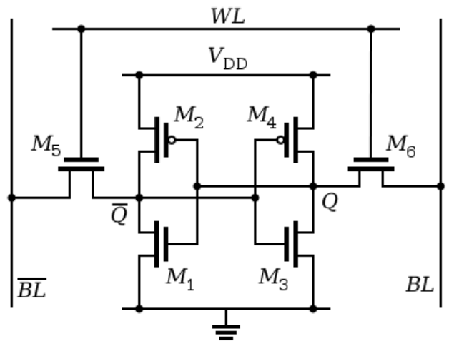
SRAM
Static Random Access Memory (SRAM)
Two cross-coupled inverters store a single bit
Feedback path enables the stored value to persist in the cell
4 transistors for storage
2 transistors to access the cell
row select
bitline
_bitline

Slide 19
DRAM
Dynamic Random Access Memory (DRAM)
One capacitor stores a single bit
Whether the capacitor is charge or discharged indicates storage of 1 or 0 value
1 capacitor for storage
1 access transistor
Capacitor leaks through RC path
DRAM cell loses charge over time
Needs to be refreshed periodically
row select
_bitline

Slide 20
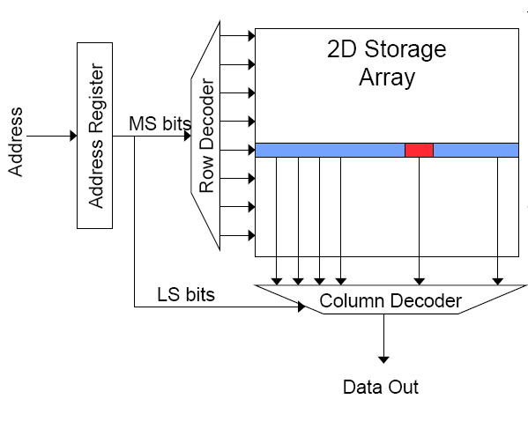
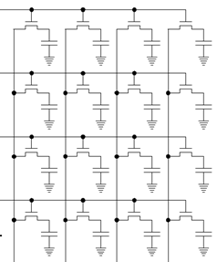
Memory bank organization and operation
DRAM read access
Decode row address and enable “row select” signal
Selected row drives bit lines. Entire row is read
Amplify row data
Decode column address and select subset of data. It is the output data

Slide 21
SRAM vs DRAM
DRAM
SRAM
Slower access (capacitor)
Higher density (1T-1C cell)
Stores more bits per units area
Lower cost
Enables bigger memory
Require refresh
Needs power and area
Reduces performance
Faster access (no capacitor)
Lower density (6T cell)
Stores less bits per unit area
Higher cost
Not suitable for big memory
No refresh required

Slide 22
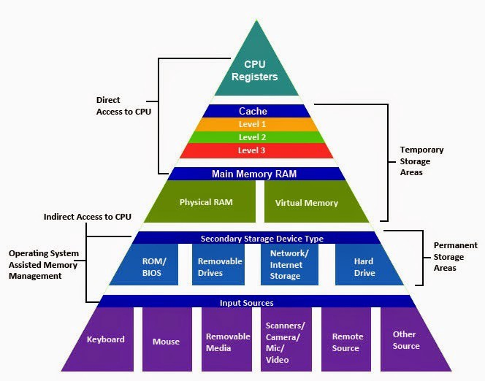
Memory hierarchy

Slide 23
Memory hierarchy idea
Use a combination of memory kinds
Smaller amounts of expensive but fast memory closer to the processor
Larger amounts of cheaper but slower memory farther from the processor
Not a new idea
“Ideally one would desire an indefinitely large memory capacity such that any particular … word would be immediately available… we are … forced to recognize the possibility of constructing a hierarchy of memories, each of which has greater capacity than the preceding but which is less quickly accessible.”
A. W. Burks, H. H. Goldstine, and J. von Neumann - 1946

Slide 24
Memory hierarchy
100s of bytes
Registers
~1ns
Upper level (small, fast)
words (4-8 bytes)
1KB – 10 MB (potentially multiple levels)
Cache (SRAM)
1-10ns
A small & fast memory near a processor
blocks (16-128 bytes)
Main Memory
(DRAM)
1 – 64 GB
~100ns
pages (1KB - 2MB)
100s GB (SSD)
1-2 TB (disk)
Disk/SSD
100μs -
10ms
Lower level (big, slow)

Slide 25
Why is memory hierarchy effective?
Temporal Locality:
A recently accessed memory location (instruction or data) is likely to be accessed again in the near future
Spatial Locality:
Memory locations (instructions or data) close to a recently accessed location are likely to be accessed in the near future
Why does locality exist in programs?
Instruction reuse: loops, functions
Data working sets: arrays, temporary variables, objects

Slide 26
Memory hierarchy in modern processors
Small, fast cache next to a processor backed up by larger & slower cache(s) and main memory give the impression of a single, large, fast memory
Take advantage of Temporal Locality:
If access data from slower memory, move it to faster memory
Take advantage of Spatial Locality:
If need to move a word from slower to faster memory, move adjacent words at same time

Slide 27


Cash Cache

Slide 28
Cache terminology
Block (or line): the unit of data stored in the cache
Typically in the ranges of 32-128 bytes
Hit: data is found in cache (this is what we want to happen)
Memory access completes quickly
Miss: data not found in cache
Must continue to search in the next level of hierarchy (could be next level cache or main memory)
After data is eventually located, it is copied to the cache

Slide 29
Cache terminology continued…
Hit rate (hit ratio): fraction of accesses that are hits at a given level of hierarchy
Hit time: time required to access a level of hierarchy
Miss rate (miss ratio): fraction of accesses that are miss at a given level of hierarchy (= 1 - hit rate)
Miss penalty: time required to fetch a block into some level from the next level down the hierarchy

Slide 30
Accessing caches
Data are identified in (main) memory by their full 32-bit address
Problem: how to map a 32-bit address to a much smaller memory, such as a cache?

Slide 31
Accessing caches
Assume 4-bit address (16-B memory)
Each address correspond to one byte
1-byte
0000
0001
Address
0010
0000
1-byte
0011
0100
16-entries
4-entries
0101
0000
0101
0100
0111
1000
Cache
1000
1000
…
How to know which of these memory locations is currently mapped to the selected cache line?
1111
Memory

Slide 32
Accessing caches
Assume 4-bit address (16-B memory)
Each address correspond to one byte
1-byte
0000
0001
Address
Valid
0010
0000
Tag
1-byte
0011
0100
16-entries
4-entries
0101
0000
0101
0100
0111
1000
Cache
1000
-
1000
…
1111
Memory

Slide 33
Accessing caches
Tag
Index
Byte offset
Address
0000
Address
0000
Data
Valid
Tag
1-byte
Valid
Tag
1-byte
1-byte
2-entries
4-entries
Cache
Cache
Direct Mapped Cache

Slide 34
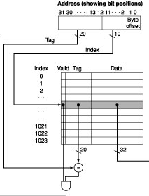
Direct-mapped cache details

Slide 35
Example problem
Given a 4 KB direct-mapped cache with 8-byte blocks and 32-bit addresses.
Question: How many tag, index, and offset bits does the address decompose into?
IMP: Cache size refers only to the size of data portion, not tags and valid bits.

Slide 36
Example problem
Given a 4 KB direct-mapped cache with 8-byte blocks and 32-bit addresses.
Question: How many tag, index, and offset bits does the address decompose into?
Answer:
8-byte block: requires a 3-bit offset
4 KB / 8 bytes per block = 512 blocks
Requires a 9-bit index
Tag: 32 – 9 – 3 = 20 bits

